Slide 1
Good tests replicate
Nicholas M. Michalak
Notes:
Nick Michalak, graduate student in social psychology at Michigan. Replication depends on good tests. Presentation inspired by conversations about replication in which people contrasted the need for good statistics and good theory.

Slide 2
Early takeaways
We can improve replication by improving hypothesis tests.
Improving tests requires focus on the statistical, methodological, and theoretical components of hypotheses.
Notes:
Before I start I’m giving you my takeaways right now.

Slide 3
What makes a good test? statistical perspective
Good tests make practical assumptions about the kinds of data they are applied to.

Slide 4

Good tests perform well when their assumptions are met
To some extent, they are ROBUST to assumption violations.
Notes:
Performance means things like bias, variance, false positive error rates, power, etc.

Slide 5
general linear model assumptions
Correct functional form
No omitted influences
Accurate measurement
Well-behaved residuals
Notes:
Because I’m assuming most people in the room use some version of the general linear model in there research, I’m going to talk about how paying attention to these assumptions can help improve replicability. Those assumptions are …

Slide 6
Well-behaved residuals
Residuals (i.e., prediction errors) aren’t correlated with other predictor variables or each other
Residuals have constant variance across values of your predictor variables.
Notes:
This is very fancy language so I’m going to explain these with more intuitive and familiar examples

Slide 7
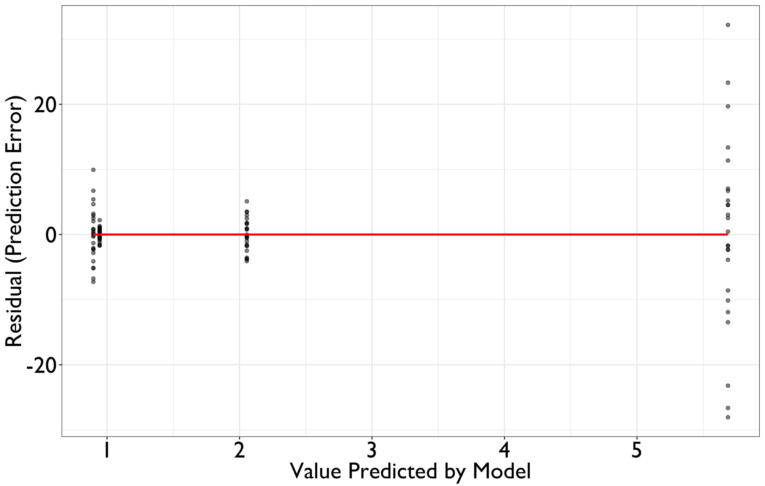
(Mis)behaved residuals
Constant variance = equal group variances
Notes:
What does it mean if residuals are behaved? Well, one way to behave is to display equal variability across the possible range of your predictor values. As you can see here, as predicted values increase, so does the spread of the points. These residuals are misbehaving.

Slide 8
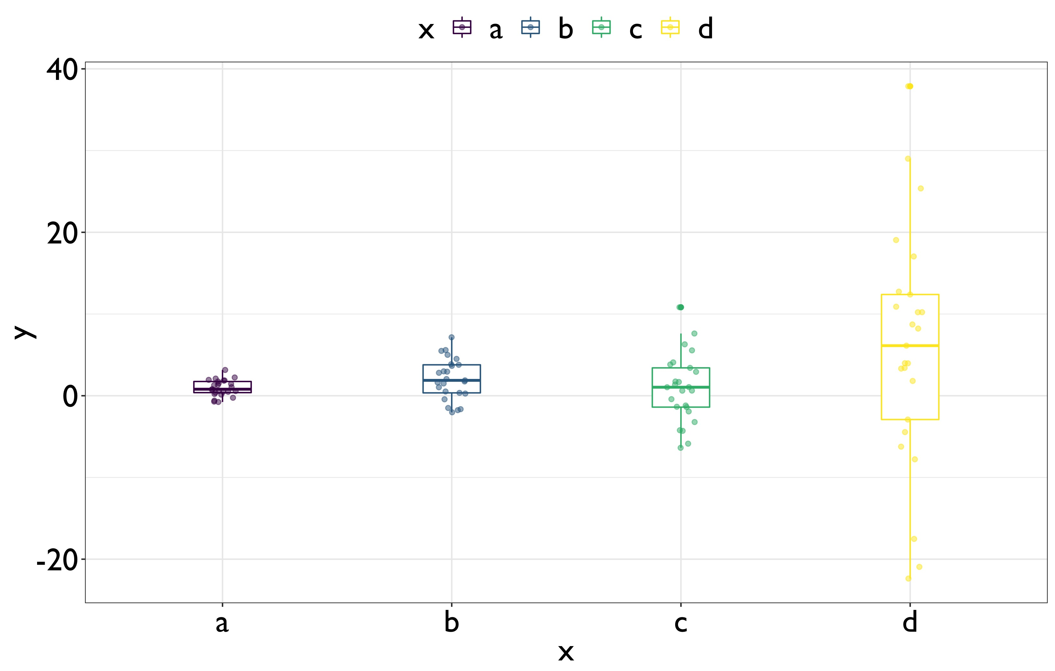
(Mis)behaved residuals
Constant variance = equal group variances
Notes:
Another way to look at this in terms of boxplots for each group. So here you can see that some groups have values that are way more spread out than in other groups. These aren’t residuals, but this kind of pattern will cause residuals to misbehave.

Slide 9
how can you improve your test when residuals misbehave?
Example: Always use the Welch t-test
Notes:
This is a very common problem in social science research, so how do we solve it? One way is to use the welch t-test.

Slide 10
Always use the welch t-test
The Welch t-test “relaxes” the equal variance assumption
When variances (and group sample sizes) are equal, the Welch t-test performs just as well as the classic Student t-test
When variances (and group sample sizes) are unequal, the Welch t-test outperforms the classic Student t-test

Slide 11
Demonstrate with simulation (1,000 t-tests on 4 group means)
Equal means
Equal sample sizes
Equal variances
Equal means
Unequal sample sizes
Unequal variances
Smallest group has smallest variance
Notes:
In case you don’t believe me, I want to show you. Imagine two real world scenarios in which the means, sample sizes, and variances are all equal.
Now imagine another scenario when they aren’t. I ran a very small simulation in which I generated data from this conditions and then I used the classic student t-test (the ANOVA really, because 4 groups), and then I also used the welch t-test.

Slide 12
Test
Classic ANOVA
Welch Correction
0.08
0.07
0.06
0.05
0.04
0.078
False Positive Rate
0.03
0.05
0.05
0.051
0.02
0.01
0.00
Equal N & Equal SD
Unequal N & Unequal SD
Notes:
Here are some brief results. Y axis represents. X axis represents. As you can see, when assumtions are met, both tests perform really well: 5% error rate just like we want. But when assumptions are violated, you can see the classic test messes up more than it should, but the welch test keeps the error rate at 5%.

Slide 13
To improve replication, always use the welch t-test
Notes:
Takeaway.

Slide 14
general linear model assumptions
Correct functional form
No omitted influences
Accurate measurement
Well-behaved residuals
Notes:
Ok back to the assumptions. Next I’m going to talk about measurement.

Slide 15
Accurate measurement
Measurements are valid and reliable
Unreliable measures can’t be valid
Reliable measures don’t necessarily measure just one construct or even your construct
Notes:
What do I mean? Well, the general linear model implicitly assumes measurements …

Slide 16
Important properties of valid and reliable psychology scales
All the scale questions measure a common latent variable.
This common latent variable accounts for the majority of the scale score variance.
Notes:
What I we mean by valid and reliable? Well …
This might seem a little abstract, so I want to show you a nice picture

Slide 17
Q1
Q2
Q3
Q4
Q5
Q6
Notes:
The idea here is that your measure causes response to your questions. Importantly, your measure can account for the majority of shared variance among your scale questions.

Slide 18

How can you diagnose a valid and reliable psychology scale?
Compute Omega Hierarchical, ω_{h}
Notes:
Measure development is hard, but I’m here to tell you there’s a well-developed way to diagnose good measures while you’re developing them or when you use them.

Slide 19
Compute omega hierarchical
Estimates variance ratio of the test variance due to a general factor
This variance ratio acts as both a reliability and a validity coefficient.
Unless all the questions measure one common construct, Cronbach’s α is invalid
Notes:
When I say it’s a validity coefficient, I don’t mean that if the ratio is high, then it’s valid. What I mean is that if it’s valid, the coefficient should be high.

Slide 20
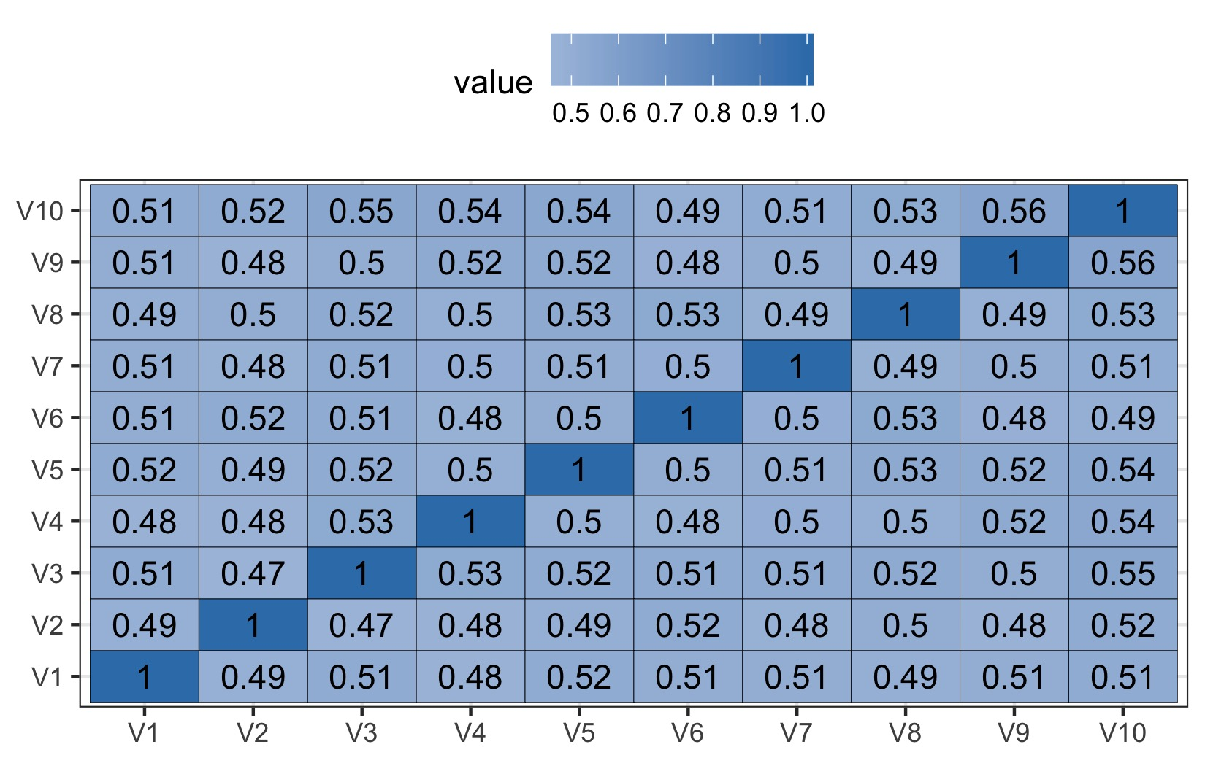
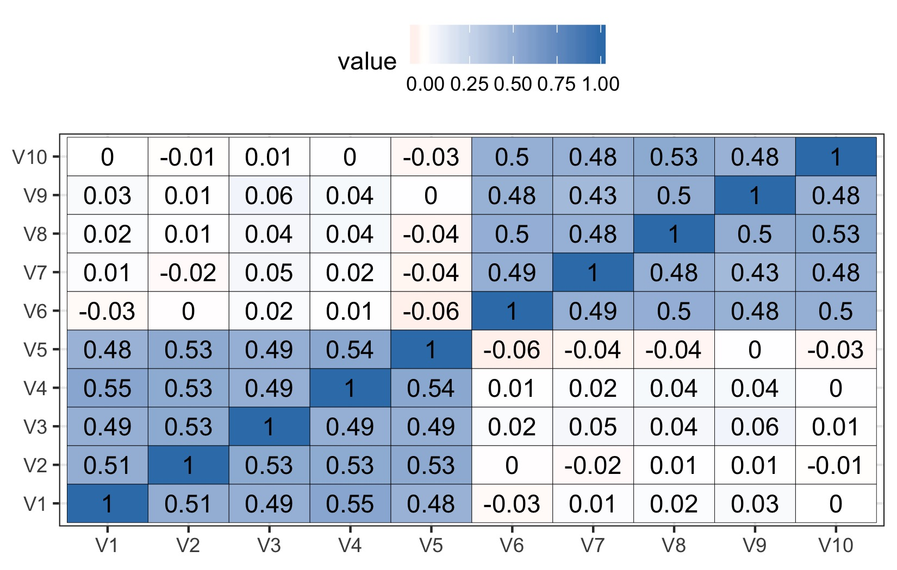
Demonstrate with simulation
Correlation matrix (1 factor)
Correlation matrix (2 factors)
Simulate data from two sets of measures that represent one or two factors
Notes:
Like it I did before with the welch test, I want to show you how this works and why it’s useful. Imagine two sets of questions. The first set of questions represent a single factor. Notice how everything is blue so they’re all correlated positively. Another set of questions form 2 factors: one subset of items correlate with each other but not with the other set and vice versa.

Slide 21
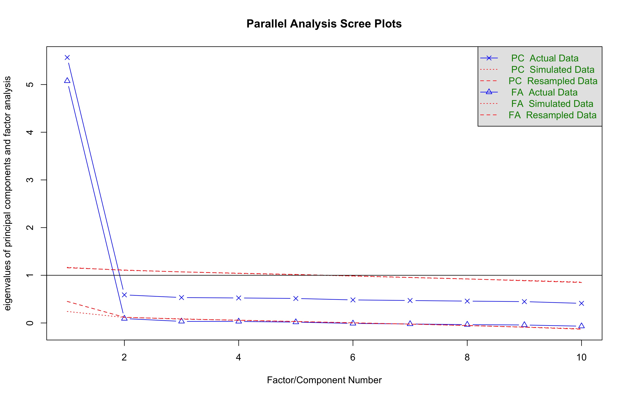
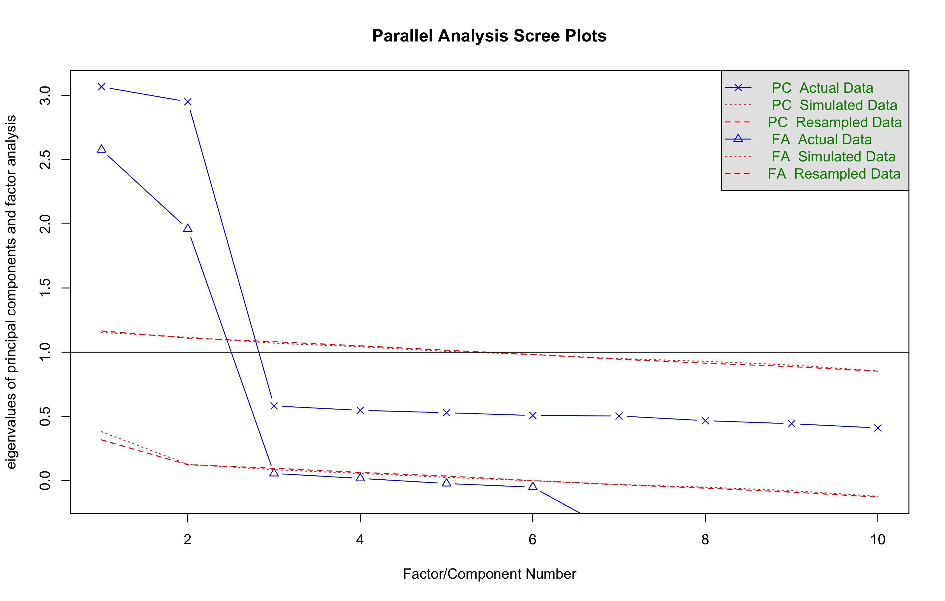
Scree Plot (1 factor)
Scree plot (2 factors)
🤔
Cronbach’s α = 0.91
Omega hierarchical, ω_{h} = 0.87
Cronbach’s α = 0.74
Omega hierarchical, ω_{h} = 0.33
Notes:
So I’m presenting the results using scree plots first. If you’re not familiar with scree plots, all you need to know is that bigger values roughly represent information explained. If you have one factor, the lions share of the variance should be explained by one thing. So when you see a steep drop, that means one thing explained a lot and the rest didn’t.

Slide 22
To improve replication, use better measures
To diagnose your measures, follow these steps:
Generate a correlation matrix
Generate a scree plot (ideally via parallel analysis)
Compute Omega hierarchical (ω_{h}) and Cronbach’s α (but remember α can mislead you!)

Slide 23
general linear model assumptions
Correct functional form
No omitted influences
Accurate measurement
Well-behaved residuals

Slide 24
Other assumptions
Correct functional form
Your statistical model variables share linear relationships
No omitted influences
Your statistical model accounts for all relevant influences

Slide 25
what if my research question is about a “u”-shaped relationship?
Correct functional form
Use the two-line test
Notes:
One example of correction function form concerns the shape of relationships. Better tests model the shape.

Slide 26
Notes:
I didn’t budget time to explain this, but the point is that the quadratic term in a regression is very often a bad representation of u-shaped data. Qudartic regressions make mistakes when there are true and false u-shaped patterns in data. The solution is to use the two-line test developed by uri simonoshn. New paper just cam out it.

Slide 27

What if my research question is about individual differences across time or conditions?
No omitted influences
Use repeated measures contrasts or linear mixed effects models
Notes:
An example of omitted influences concerns individual differences. Better tests model these differences.

Slide 28
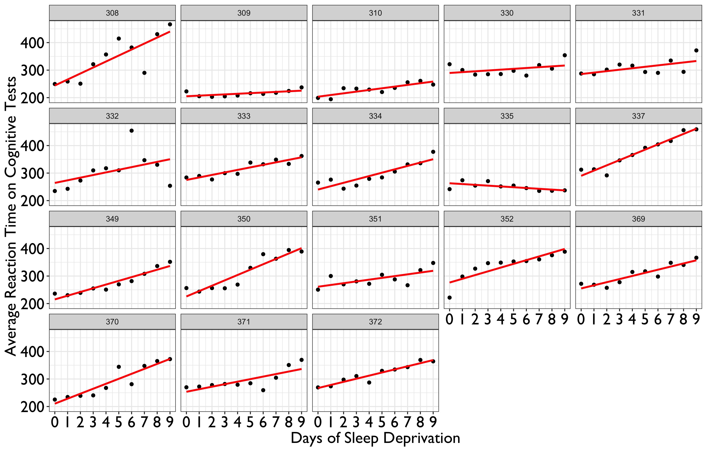
Your model should account for individual patterns (slopes) and averages (intercepts)
Notes:
As you can see here, different individuals have different slopes and even different averages. Like I said before, better tests appropriately model these influences.

Slide 29
What makes a good test? theoretical perspective
Good tests stem from good study design
Their results clearly (dis)confirm specific predictions
Notes:
Now, of course, statistics are not the only defining feature of a good test.

Slide 30
You have a research question—what study design best answers it?
Pilot test stimuli that represent relevant variance in theoretical domain
Ask participants to what they think about stimuli or even have them generate stimuli
Experimental manipulations or interventions are like stimuli—there’s a “universe” of intervention and/or manipulation procedures
Notes:
When you design a test, you should develop stimuli and manipulations that clearly represent your contrsucts. One way to do this is to ask participants.

Slide 31

along what dimensions do people distinguish among social groups in the united states?
Example
“The ABC of stereotypes about groups” Koch et al., 2016
Notes:
One of my favorite examples comes from a research paper by Koch and colleagues. They asked

Slide 32
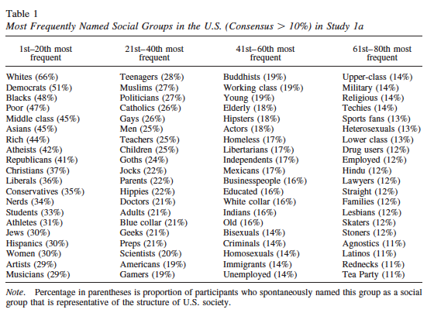
They asked people to list social groups in the U.S.

Slide 33
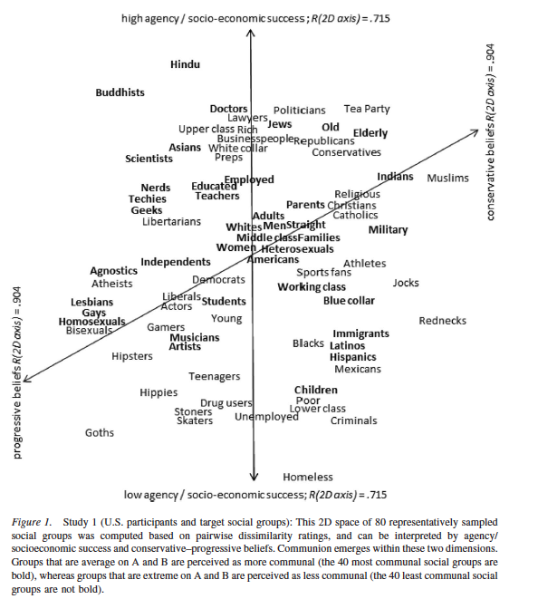
And then they had separate people (1) categorize them on similarity and (2) rate them on theoretical dimensions
Participants listed the groups
Participants used their own dimensions
Only later did researchers interpret dimensions
Participant-driven research design
Notes:
Agency and conservative beliefs

Slide 34
To Improve replication, generate more representative stimuli

Slide 35

Specific predictions and tailored designs make better tests and improve replication
Notes:
Specfic questions are falsifiable
Researchers can better design studies that test more specific questions than more vague predictions
Independent researchers can more easily design new studies to replicate specific predictions

Slide 36
takeways
We can improve replication by improving hypothesis tests.
Improving tests requires focus on the statistical, methodological, and theoretical components of hypotheses.

Slide 37
resources
Welch t-test
SPSS: ONEWAY command (IBM overview)
R: See quantitative methods course materials from Douglas Bonett (PSYCH 204); also, see my website nickmichalak.com/blog
Omega hierarchical
R only: omega function in the psych package (Using R and psych for personality and psychological research)
Two-line test
Web application: http://webstimate.org/twolines

Slide 38
Relevant references
Judd, C. M., Westfall, J., & Kenny, D. A. (2017). Experiments with more than one random factor: Designs, analytic models, and statistical power. Annual Review of Psychology, 68, 601-625.
Koch, A., Imhoff, R., Dotsch, R., Unkelbach, C., & Alves, H. (2016). The ABC of stereotypes about groups: Agency/socioeconomic success, conservative–progressive beliefs, and communion. Journal of Personality and Social Psychology, 110, 675-.
Simonsohn, U. (2017). Two-lines: The first valid test of U-shaped relationships. Advances in Methods in Practices in Psychological Science.
Zinbarg, R., Yovel, I., Revelle, W. & McDonald, R. (2006). Estimating generalizability to a universe of indicators that all have one attribute in common: A comparison of estimators for omega. Applied Psychological Measurement, 30, 121-.
Maxwell, S. E., Delaney, H. D., & Kelley, K. (2017). Designing Experiments and Analyzing Data: A Model Comparison Perspective. Routledge.

Slide 39

THANK YOU
nickmichalak.com
@nmmichalak
Slides. https://osf.io/rdbmh/

